Slide 1

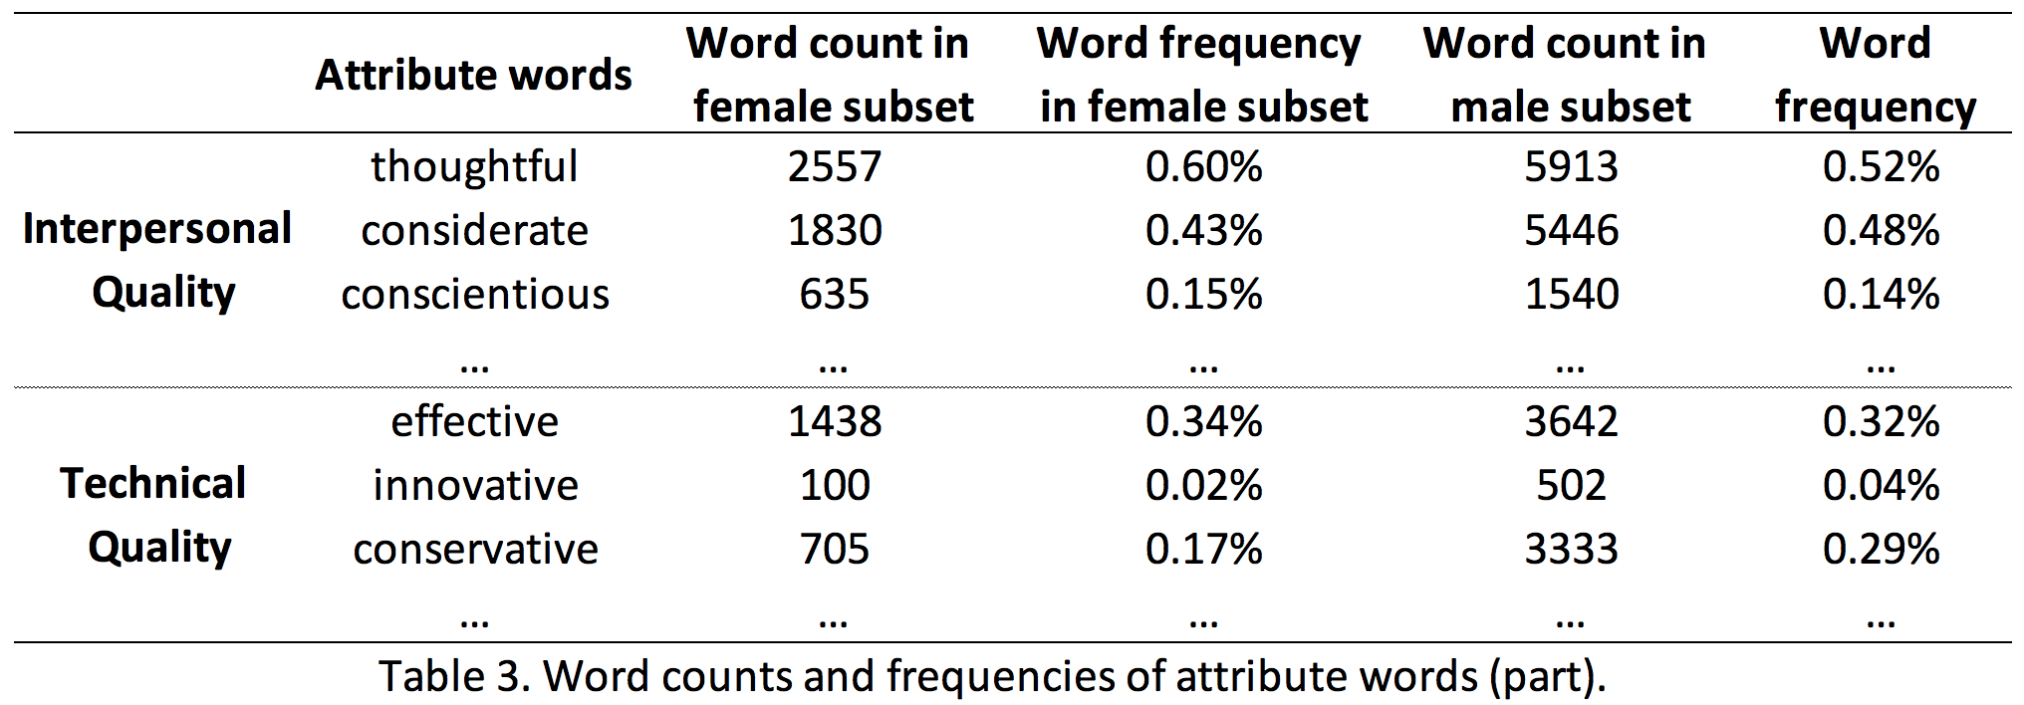
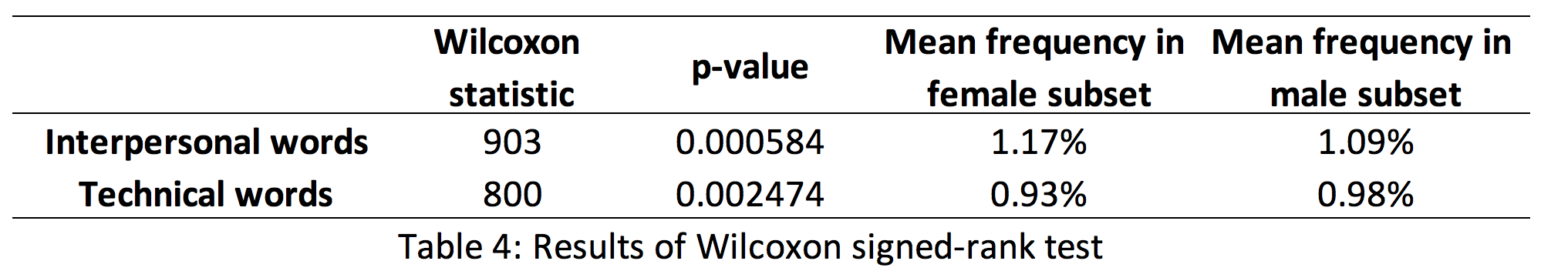
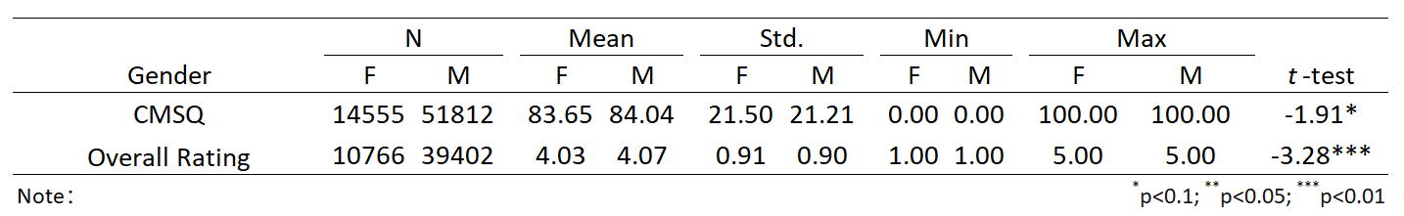
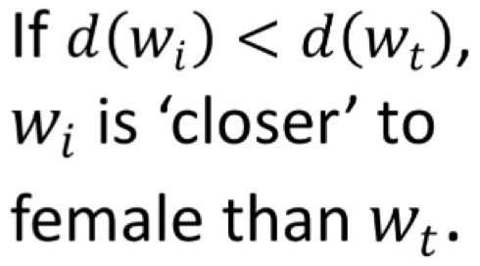
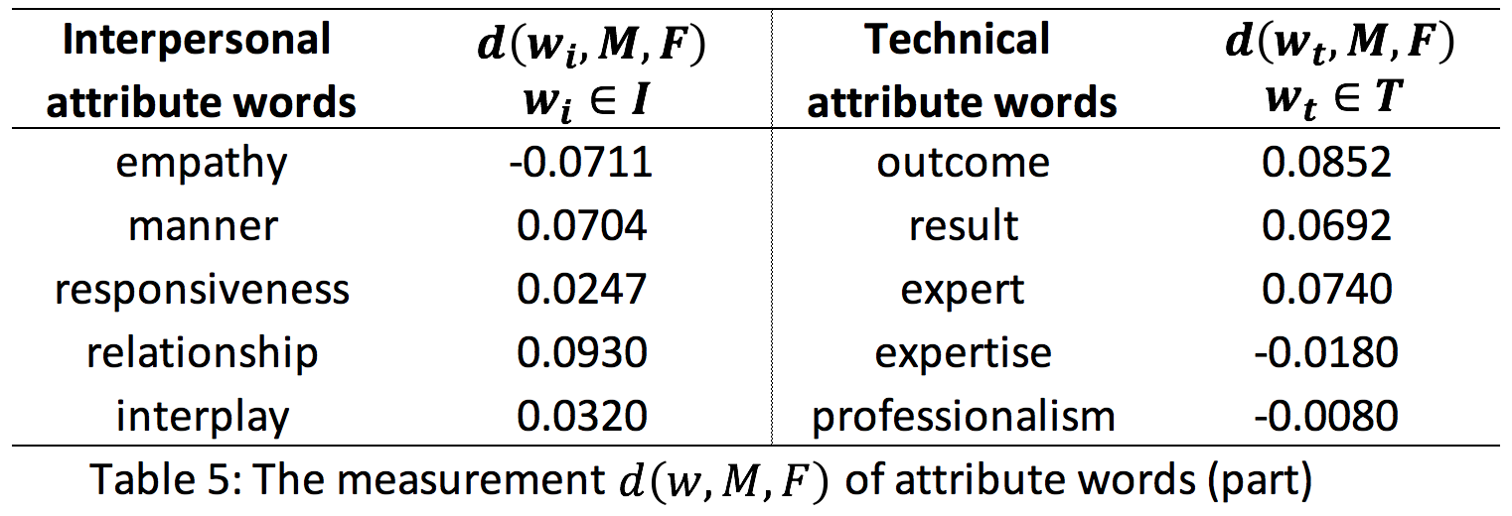
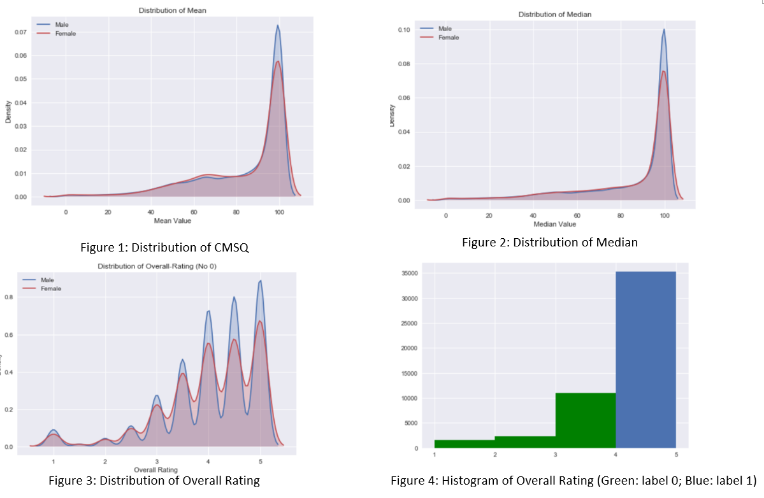
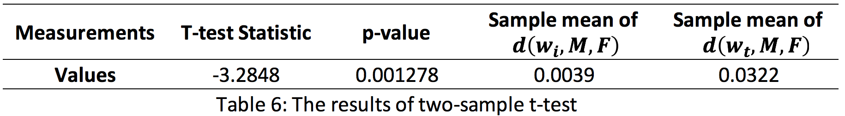
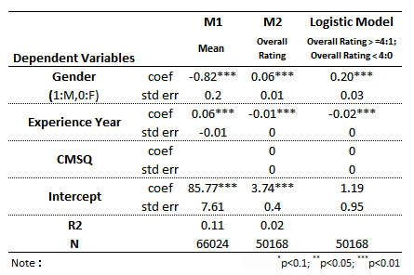
Gender Bias in Online Ratings and Reviews for Physicians Jujun Huang, Xiao Wan Instructor: Professor Feng Mai
Business Intelligence & Analytics
June 8th, 2018
Introduction
Patients are increasingly relying on online reviews to choose doctors. We show that gender bias exists in online physician reviews. Female doctors are less likely to receive high online ratings. Gender stereotypes also emerge in word embeddings models trained using textual comments.
Highlights:
Real data: Online ratings and reviews come from a leading doctor ratings website and a federal agency.
Comprehensive dataset: We merge 1.8 millions online reviews with more than 60,000 physicians’ healthcare quality data.
Combining quantitative and qualitative analysis: We use econometrics and machine learning techniques to analyze both numeric and textual data.
Evidence From Patient Comments：
Data Preprocessing
- Spellcheck and lemmatize the textual data
- Verify gender identity and ensure the object of comment
- Collect attribute words widely used for physician evaluation
Word Frequency
H₀: Word frequencies describing the two quality dimensions do not differ by the gender of the physicians.
Result: Interpersonal words are more frequently used to assess female doctors than male. Technical words are on the contrary.
Word Embedding
In word embedding models, the semantics relationships between two words can be measured by the cosine similarity of the word vectors. We trained a word embedding model using textual comments from physician reviews. Define
Apply T-test for
H₀: Their average (expected) values do not significantly differ.
Result: Interpersonal words, compared to technical words, have stronger association with female physicians.
Evidence From Star Ratings：
Data Source
We use web crawler to collect the Overall Star Ratings (OR) from a leading healthcare website. OR is an overall score (1-5 star) patients gave to physicians.
We collect additional data from Centers for Medicare and Medicaid Services (CMS). Physicians voluntarily report their quality measures (CMSQ) to the agency.
Descriptive Statistics
Regression Models
Table 1: Summary of Descriptive Statistics
On average, male physicians have slightly better CMSQ.
But after controlling for experience, female physicians have better CMSQ (Model M1).
Conclusion
Gender Bias manifests in online physician reviews in different ways.
Patients hold different standards for male/female doctors.
Implications
Managers and designers of online review website should add guidelines or suggestions for reviews and improve the evaluation mechanism for ratings.
Physicians should be cautious when they use the online information for learning and improving.
Researchers need to pay attention to the latent bias when using online rating data or textual materials.
Table 2: Result of Regression Models
We use Logistic Regression and OLS Regression. Controlling for CMSQ, female physicians are less likely to receive a 4 or 5 star rating online (Model M2 and Logistic Model).
http://www.stevens.edu/howe/academics/graduate/business-intelligence-analytics

